Slide 1
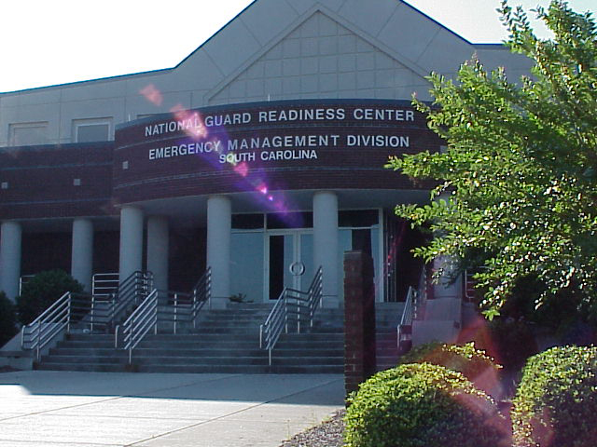
SOUTH CAROLINA EMERGENCY MANAGEMENT DIVISION
Disaster Update
January 2021

Slide 2
Agenda
SCEMD Mission
February 2020 Severe Storms
April 2020 Tornados
COVID-19
Disaster Cost Summary

Slide 3
SCEMD Mission
The South Carolina Emergency Management Division leads the state emergency management program by supporting local authorities to minimize the loss of life and property from all-hazard events.
Notes:
T

Slide 4
February 2020 Severe Storms
Line of severe storms moved through South Carolina 6-7 February:
Most heavily impacted the western and northwestern counties
Heavy rain, strong straight-line winds, and two confirmed tornadoes
Rainfall totals in the most heavily affected counties ranged from 6.66” to 9.27”
Storm Related Deaths: 1
Power Outages: 51,000 customers

Slide 5
February 2020 Severe Storms (cont)
Road/Bridge Closures: 100
Residential Damage: Limited and was not enough for a Small Business Administration declaration (more than 25 uninsured homes/businesses)
Infrastructure damage estimate: $13,312,232

Slide 6
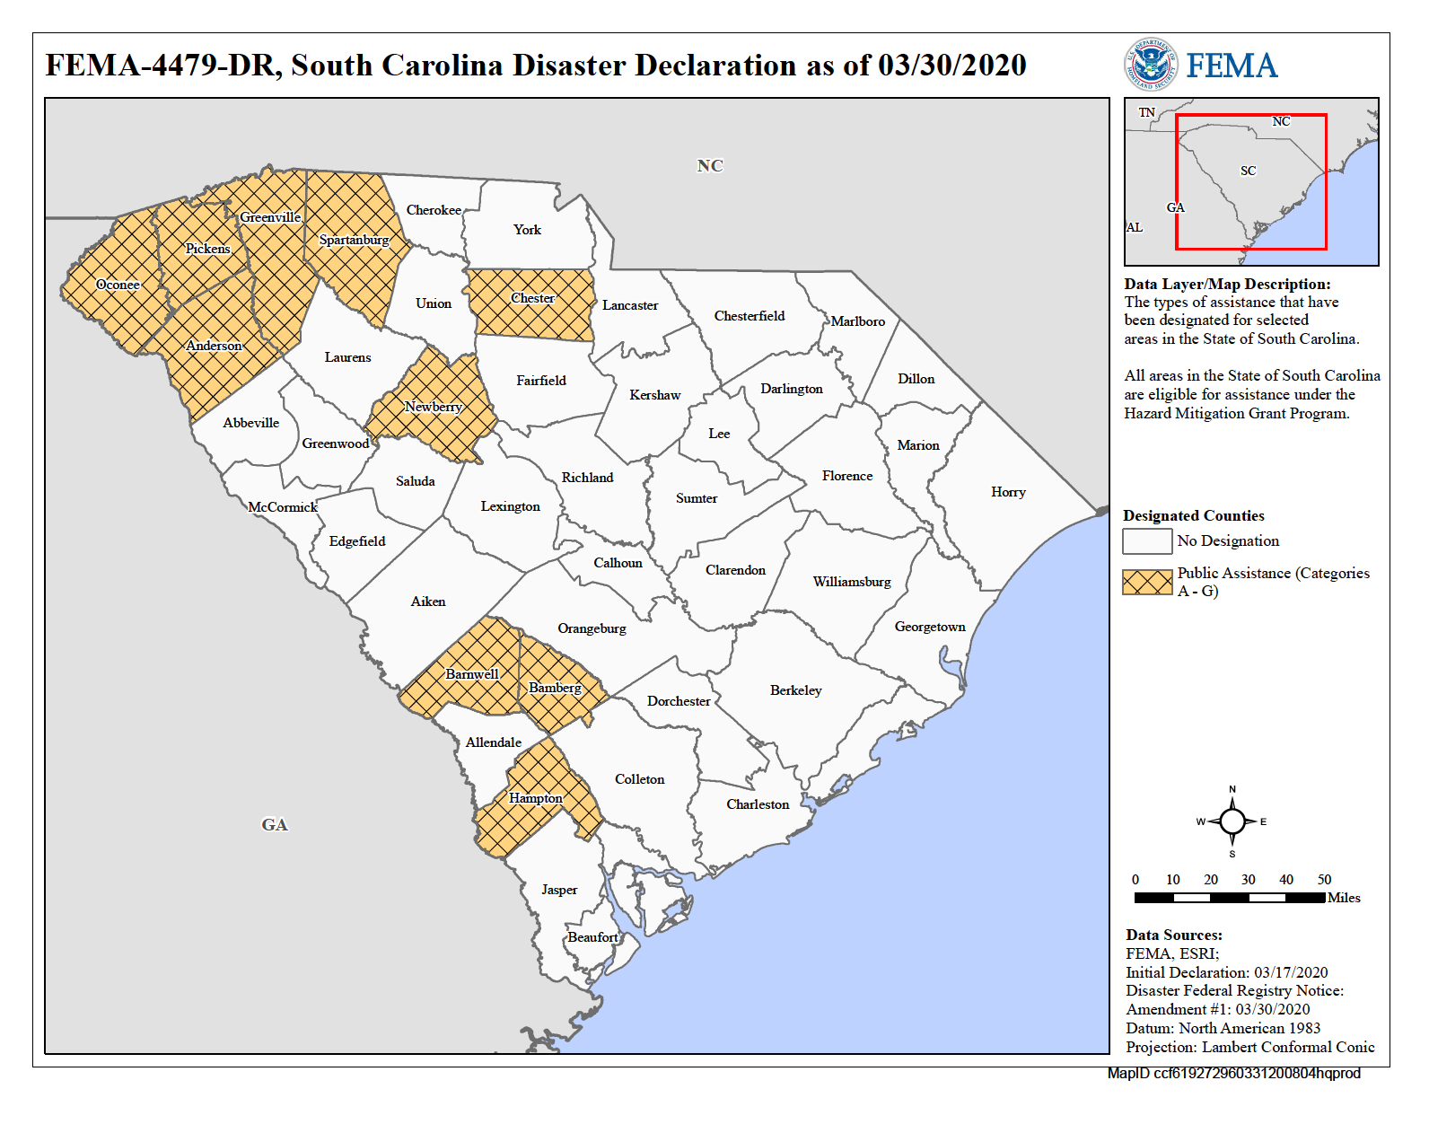

Slide 7
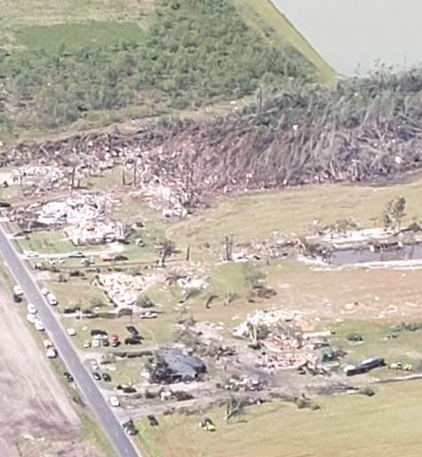
April 2020 Tornados
Several lines of severe storms impacted the state on the night of 12 April and into the morning of 13 April
Storms generated 27 tornadoes
Heaviest hit areas included Hampton, Oconee and Pickens Counties
Storm related deaths: 9
Power outages: 290,000 customers
Road/Bridge Closures: 2,500
Sheltered Population: 236

Slide 8
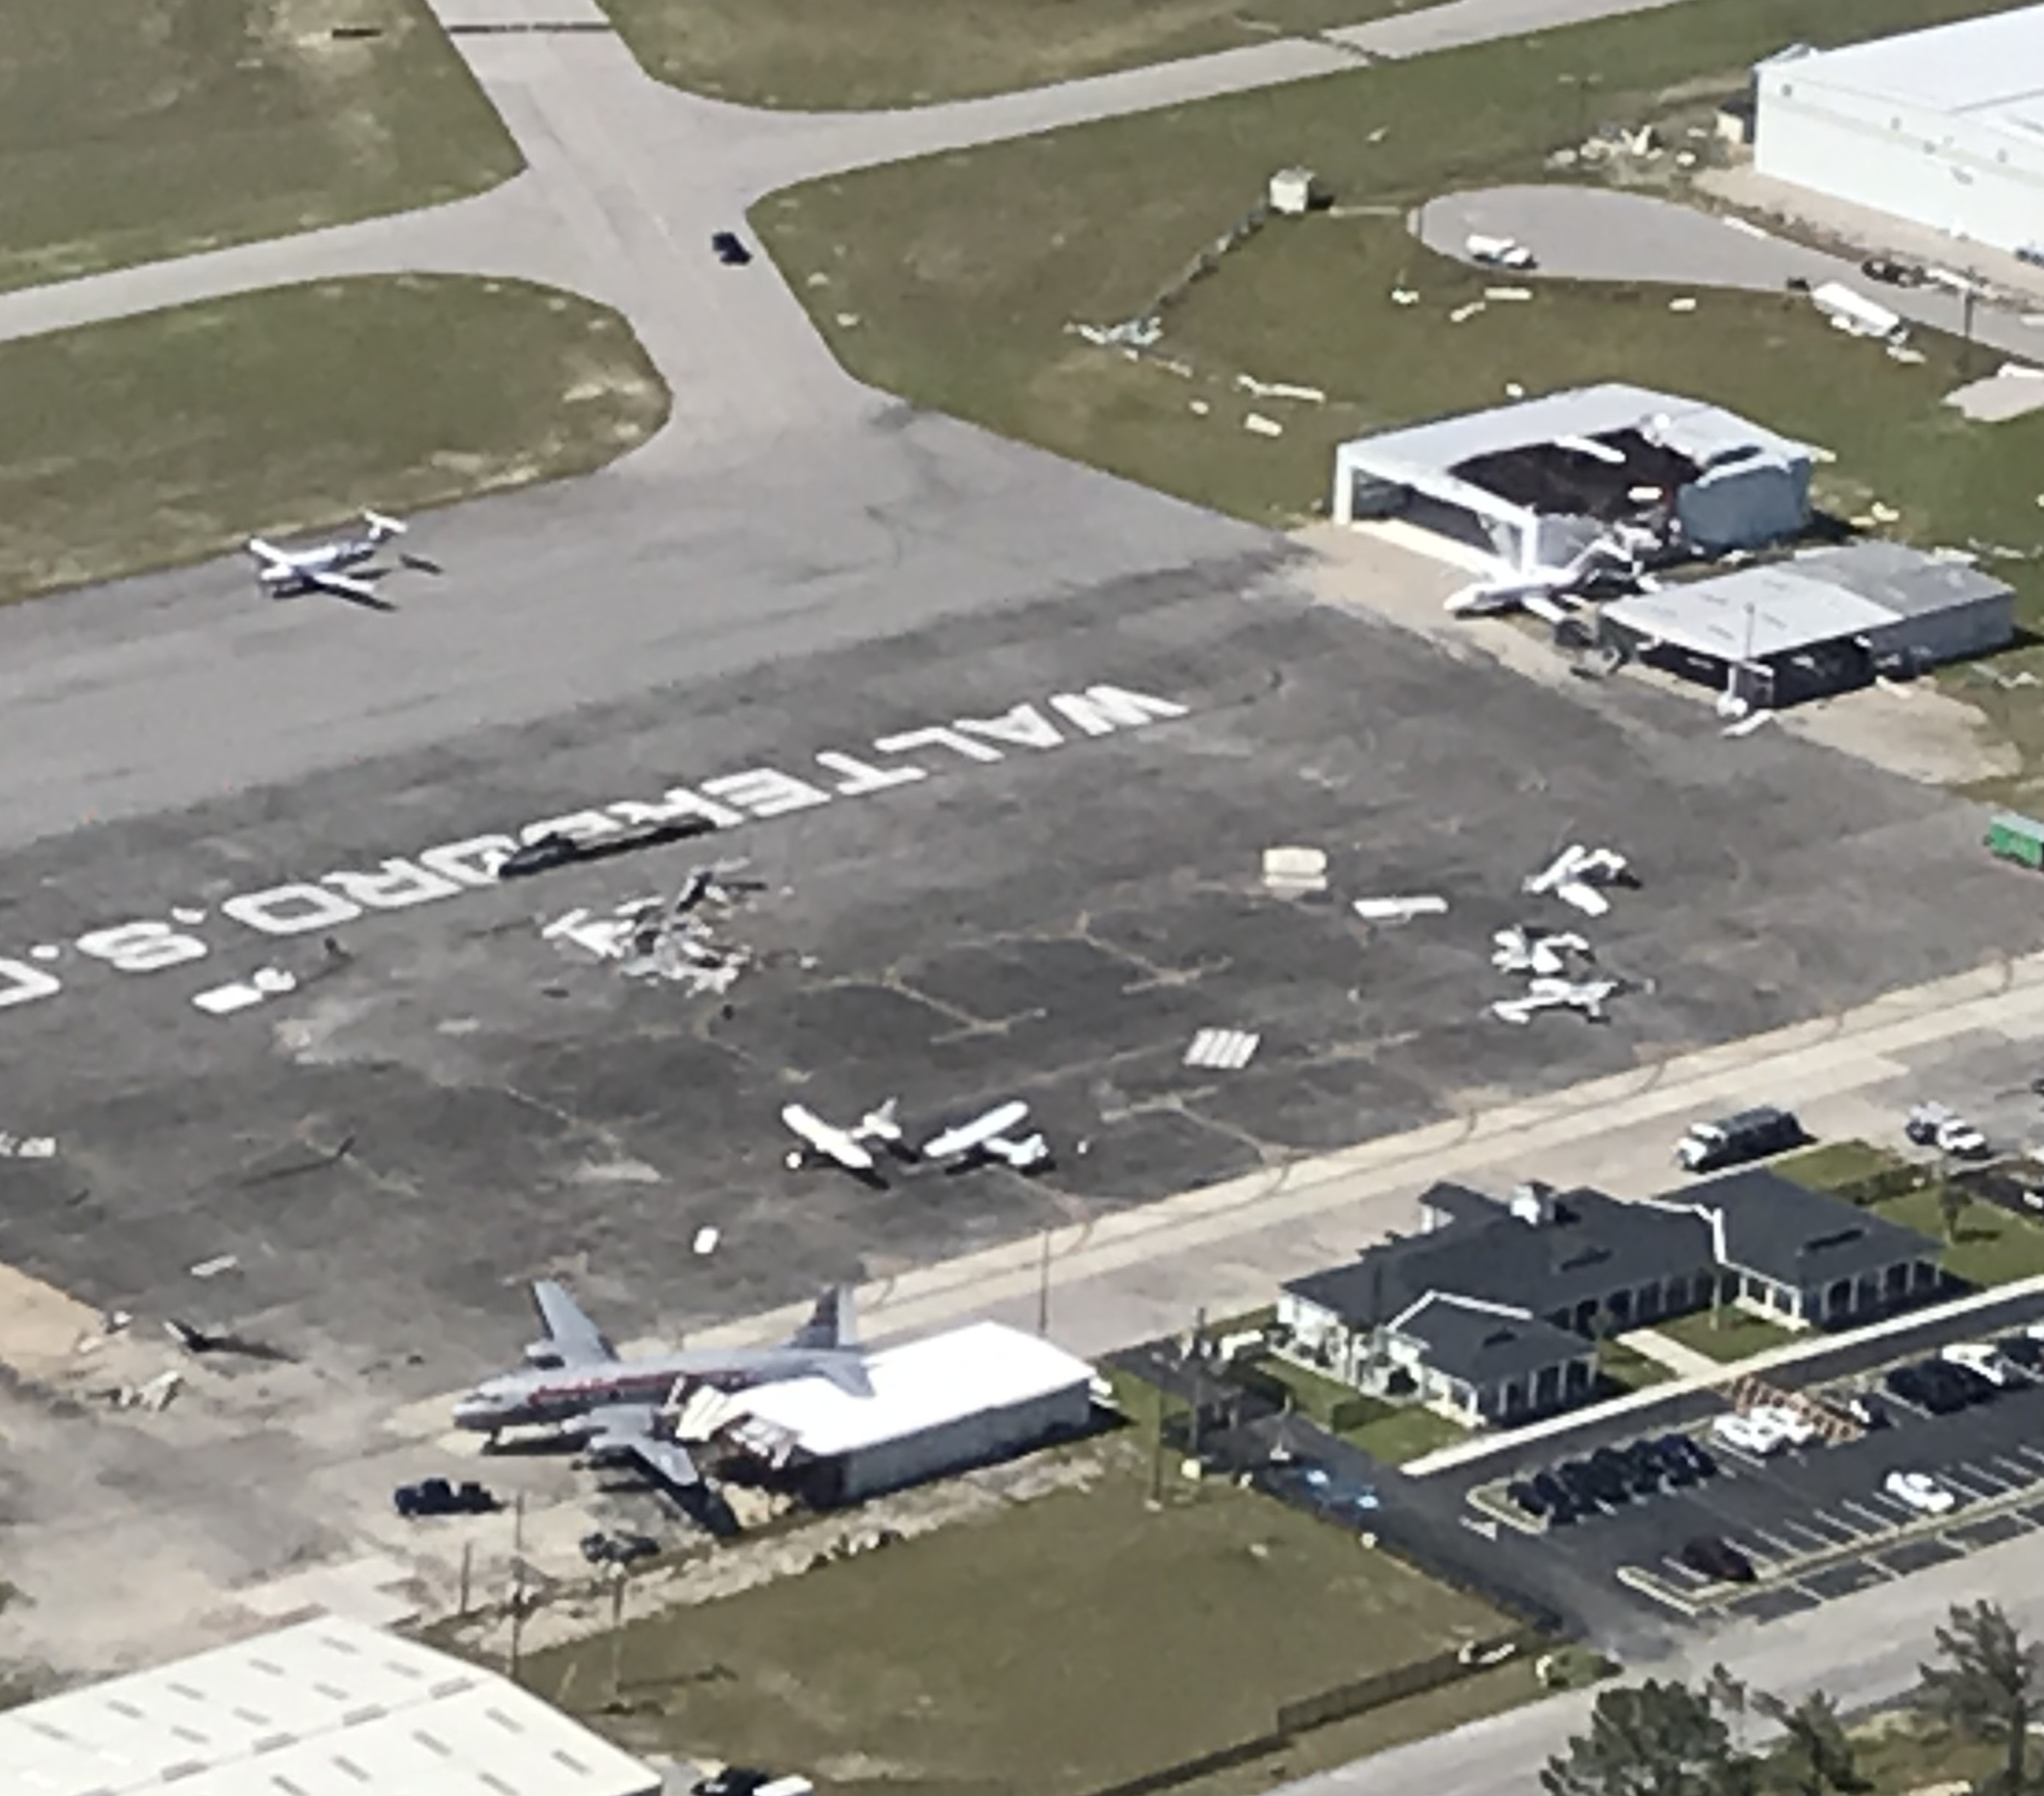
April 2020 Tornados (cont)
Residential damage total: 1,581
Destroyed: 211
Major Damage: 217
Minor Damage: 305
Affected: 848
SBA Assistance: $6,781,500
FEMA Individual Assistance: $5,365,831
Infrastructure damage estimate: $24,040,690

Slide 9
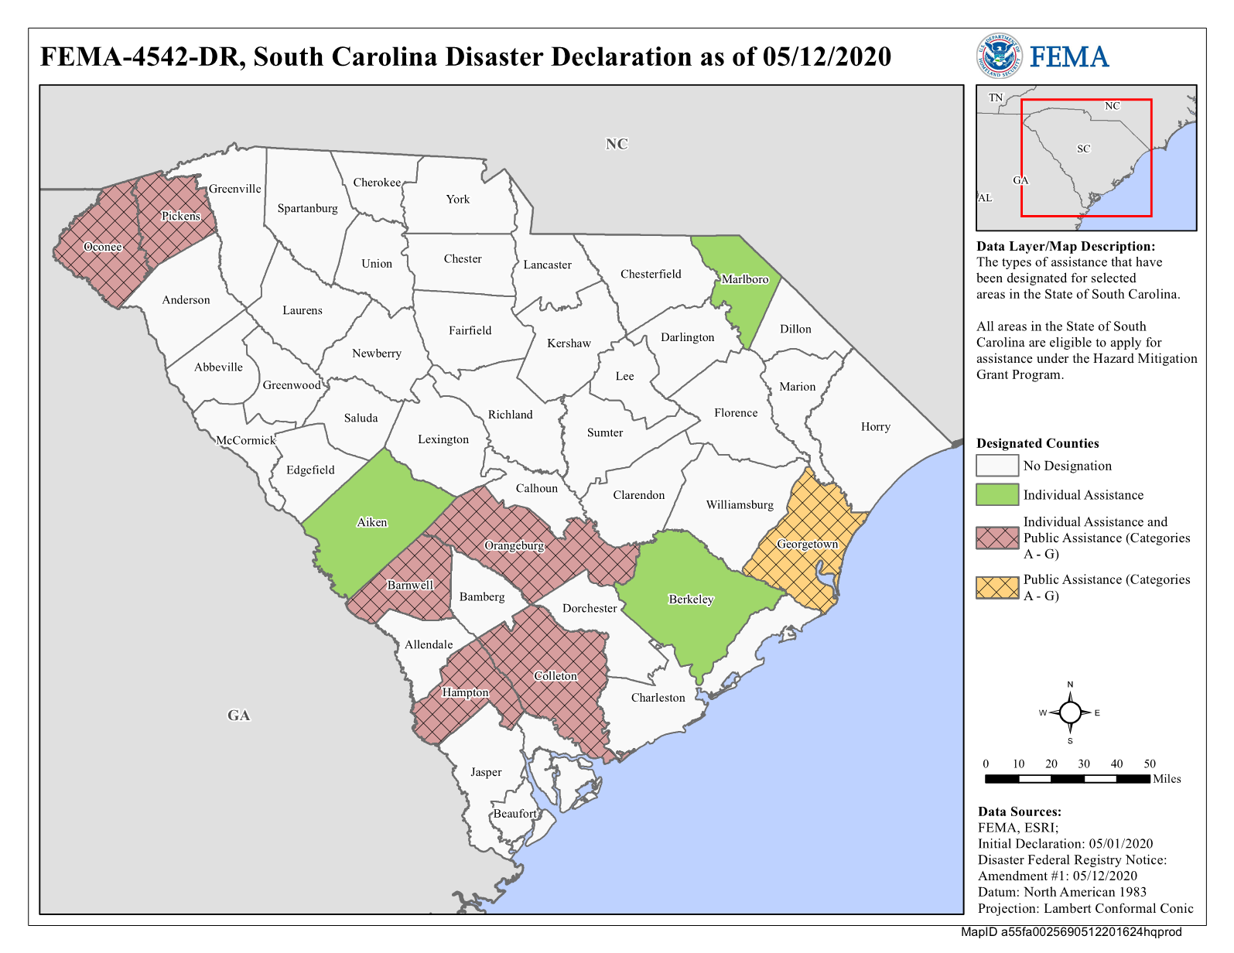

Slide 10
COVID-19
Different than natural disasters with no:
Evacuation
Road and bridge closures
Power outages
Residential and business damages
Logistics requests: Over 4,200 and counting
Personal Protective Equipment
Cleaning supplies
Testing support
Emergency Protective Measures Estimate: $293.8M

Slide 11
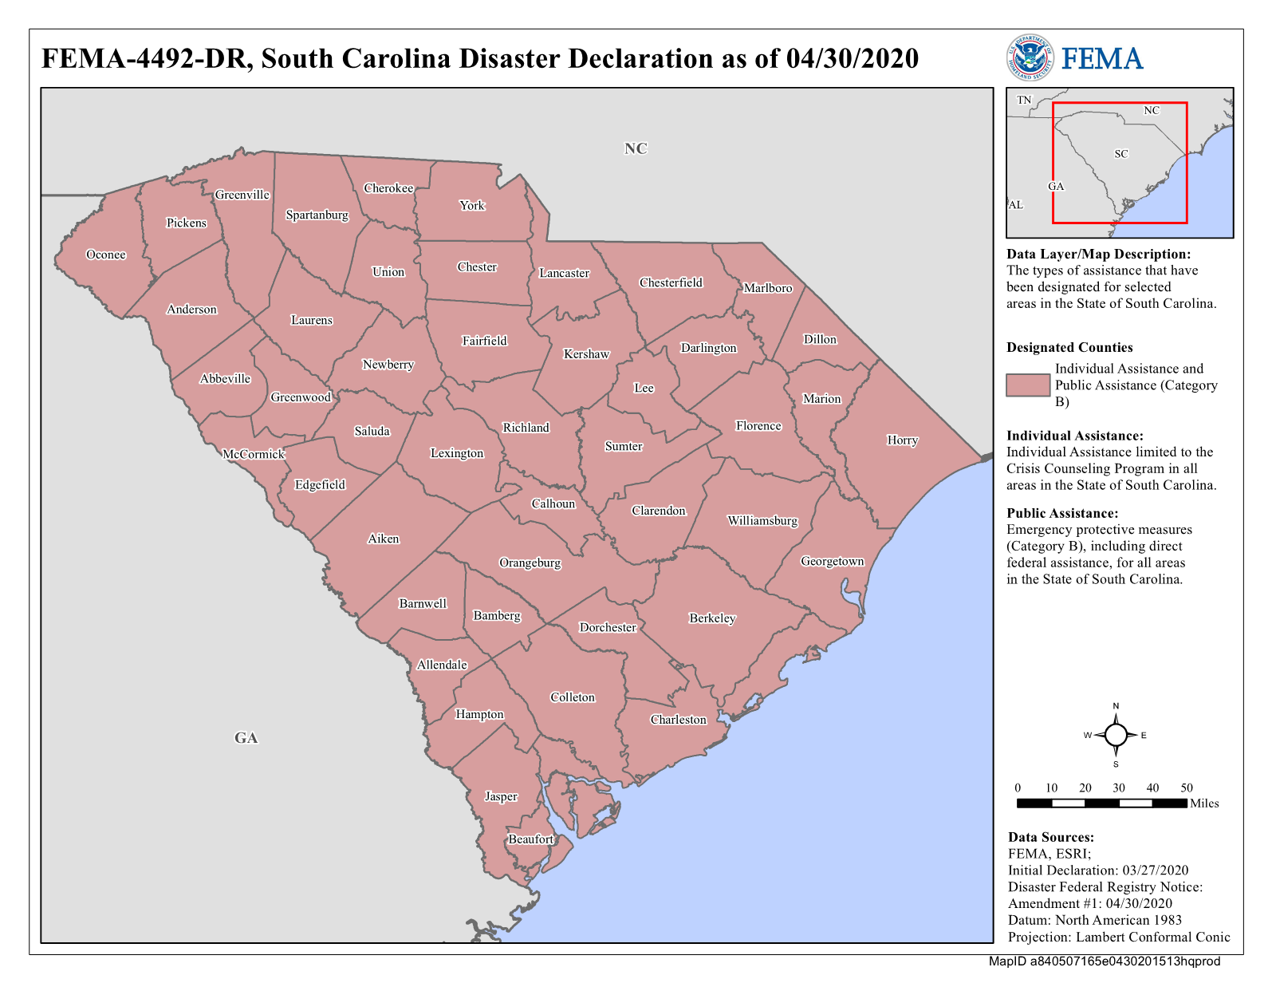

Slide 12
Major Federal Programs
Federal Emergency Management Agency (FEMA)
Individual Assistance - Families and individuals
Public Assistance - Government organizations and certain non-profits
Hazard Mitigation Grant Program – Designed to reduce impacts of future disasters
Small Business Administration
Physical Disaster Loans
Economic Injury Disaster Loans

Slide 13
FEMA Program Non-Federal
Cost Share
Public Assistance – 25%
Individual Assistance
Housing 100% funded
Other Needs Assistance – 25%
Hazard Mitigation Grant Program: 25%

Slide 14
Disaster Declaration Summary
Disaster | Individual Assistance | Estimated Public Assistance | Mitigation Estimates | State Share Appropriation (Initial)
2014 Ice Storm | None | $264,657,498 | $43,234,524 | $7,439,969
2015 Flood | $89,903,713 | $193,803,386 | $64,049,619 | $72,000,000
2016 Hurricane Matthew | $39,700,862 | $321,076,771 | $58,332,265 | $68,000,000
2016 Pinnacle Mountain Fire | None | $4,453,505 | $566,677 | $1,250,000
2017 Hurricane Irma | None | $43,638,989 | $6,327,144 | $10,884,859
2018 Hurricane Florence | $24,521,753 | $127,507,367 | $22,947,644 | $22,000,000
December 2020

Slide 15
Disaster Declaration Summary (cont)
Disaster | Individual Assistance | Estimated Public Assistance | Mitigation Estimates | State Share Appropriation (Initial)
2019 Hurricane Dorian | None | $55,488,350 | $5,640,656 | TBD
2020 February Storms | None | $13,312,232 | $1,453,923 | TBD
2020 COVID-19 | None | $293,807,255 | N/A | TBD
2020 April 13 Tornadoes | $5,365,831 | $24,040,690 | $1,864,645 | TBD
December 2020

Slide 16
Non-Federal Share Summary By Disaster
Disaster | Estimated Non-federal Share | State Appropriation | + (-) | State Share Payments to Date
2014 Ice Storm | $15,817,398 | $16,434,628¹ | $617,230 | $15,817,398
2015 Flood | $49,801,517 | $52,876,101² | $3,074,584 | $29,639,350
2016 Hurricane Matthew | $64,237,344 | $67,300,000³ | $3,062,656 | $52,642,201
2016 Pinnacle Mountain Fire | $1,112,144 | $1,250,000⁴ | $137,856 | $1,112,144
2017 Hurricane Irma | $8,541,623 | $9,629,240⁵ | $1,087,617 | $6,510,921
2018 Hurricane Florence | $26,152,990 | $21,580,000 | -$4,572,990 | $14,346,947
¹ Includes an original appropriation of $7,439,969 and moving $8,994,659 from 2015 Flood surplus State appropriation
² Original appropriation was $72,000,000; reduced by funds reallocated to 2014 Ice Storm ($8,994,659), Hurricane
Irma ($9,629,240), and 2015 Flood Voluntary Agency Housing Repair Assistance ($500,000)
³ Original appropriation of $68 million included $700,000 earmarked for Nichols
⁴ Funds reallocated from 2015 flood appropriation, not a separate appropriation of funds
⁵ Original appropriation of $22 million included $420,000 earmarked for Horry generators
December 2020

Slide 17
Non-Federal Share Summary By Disaster (cont)
Disaster | Estimated Non-federal Share | State Appropriation | + (-) | State Share Payments to Date
2019 Hurricane Dorian | $10,993,844 | TBD | N/A | $0
2020 February Storms | $3,192,341 | TBD | N/A | $0
2020 COVID-19 | $73,451,814¹ | TBD | N/A | $0
2020 April 13 Tornadoes | $4,981,975 | TBD | N/A | $152,626²
¹ Inclusive of all applicants, including PNPs and hospitals. A portion of these costs will be offset by Coronavirus Relief Fund (CRF) funding from the Department of Administration.
² Required Payment to FEMA of state share of Individual Assistance Other Needs Assistance (ONA) program costs.
December 2020

Slide 18
Disaster Non-Federal Share Summary
Total Estimated Non-Federal Share | $258,282,991
Total Current State Appropriations Available for Non-Federal Share | $169,069,969
CRF Funding for Current Estimated COVID-19 Non-Federal Share¹ | $73,451,814
Total Estimated New Appropriation Needed (In addition to CRF) | $15,761,208
¹ SCEMD requested $75,538,871 in Coronavirus Relief Fund (CRF) monies to cover the non-Federal share of COVID-19 Public Assistance (PA) projects. These funds cannot be used for the non-Federal share of costs related to other disasters.
December 2020

